Slide 1
CSC – 183 Programming C
Chapter - 5
Decision Making and Branching

Slide 2
Today’s Outline:
Introduction
Decision Making statements in C
Simple if statement
if_else statement
else_if ladder
nested if_else statement
switch statement
goto statement

Slide 3
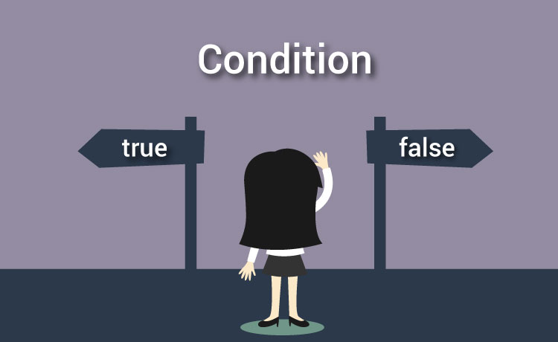
Decision Making and Branching

Slide 4
Introduction :
C statements are normally executed sequentially in order they appear.
In practice, depending on situation may have to change the order of execution of statements based on certain conditions, or repeated a group of statements until met certain conditions.
In this kinds of situation need to take decision, and according to the decision the flow or execution order of statements are changed.
That’s why it is called Decision Making and Branching.

Slide 5
Decision Making statements in C :
if statement
switch statement
Conditional operator statement (?:)
goto statement

Slide 6
Simple if Statement :
Format:
if ( test condition )
statements;
Example:
scanf( “ %f “ , &marks );
if( marks >= 80 )
printf( "Yes, the student get A+“ );

Slide 7
Simple if Statement :
Format:
if ( test condition )
statements;
Example:
if( category == SPORTS )
{
marks = marks + bonus_marks;
}
printf( " Marks = %f " , marks );

Slide 8
Simple if Statement : (flowchart)
Entry
Test
Expression
?
True
Statement-block
False
Statement - x
Next Statement

Slide 9
Simple if Statement : (Program)
If category is SPORTS, then add bonus_mark with marks.
Count number of boys weight is less than 50 kg and height is greater than 170 cm.
Check divide by 0 ‘Zero’ condition in division operation.
Write C program to print the square of a number if it is less than 10.
Check a number is greater, smaller or equal to another number.

Slide 10
if_else Statement :
Format:
if ( test condition )
statements;
else
statements;
Example:
if( num % 2 == 0 )
printf( “Even number’’ );
else
printf( “Odd number” );

Slide 11
if_else Statement : (flowchart)
Entry
Test
Expression
?
True
False
True-block
statement
False-block
statement
Statement - x

Slide 12
If-else Statement : (Program)
Find out larger number between two numbers.
Check a number even or odd.
Check a number is Numbers are divisible by any other numbers.
Check two values are equal or not.
Check a marks is valid or invalid.
Check a candidate is eligible or not. (age and gpa)

Slide 13
nested if_else Statement
When a series of decisions are involved, we may have to use more than one if…else statement in nested form.
Nested means one if statement inside of another if_else statement.
So, when one if statement appears inside of another if statement for decision making is called nested if…else
In nested if…else, nested if (inside one)may appear inside if or else statement.

Slide 14
nested if_else Statement
Format:
if ( condition )
if ( condition )
statement1;
else
statement2;
else
statement3 ;
Example:
if(a>b)
{
if(a>c)
printf("a is the largest:%d",a);
else
printf("c is the largest:%d",c) ;
}
else
{
if(c>b)
printf("c is the largest:%d",c);
else
printf("b is the largest:%d",b) ;
}

Slide 15
nested if_else Statement (Example)
int main()
{
float salary, bonus;
if(gender == FEMALE)
{
if(salary > 10000)
bonus = salary * 0.5;
else
bonus = salary *0.2;
}
else
{
bonus = salary * 0.3;
}
salary = salary + bonus;
return 0;
}

Slide 16
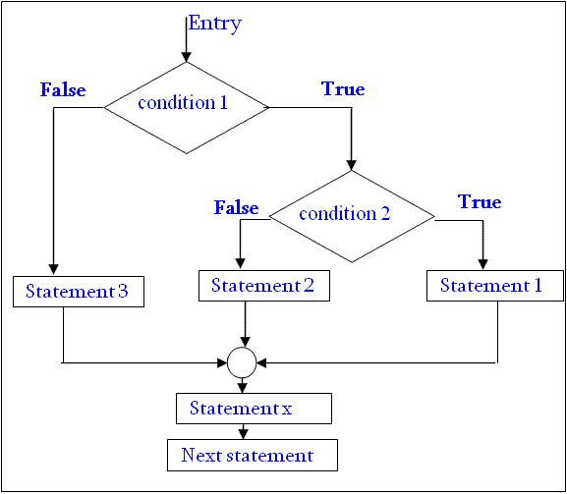
nested if_else Statement

Slide 17
else_if ladder Statement
This is another way of putting if’s together what multiple decision are involved.
A multipath decision is a chain of if’s in which the statement associated with each else is an if.
If any of the conditional expression evaluates to true, then it will execute the corresponding code block and exits whole if-else ladder.
The conditions are evaluated from the top to downwards.
If all conditions are false, then the final else containing statement(s) will be executed as a default.

Slide 18
else_if ladder Statement
Format:
if(condition 1)
statements;
else if(condition 2)
statements;
else if(condition 3)
statements;
. . . . . . . . . . . . . . . .
else if(condition n)
statements;
else
default statement;
Example:
if( marks > 79 )
printf( " Honours " );
else if( marks > 59 )
printf( " First Division " );
else if( marks > 49 )
printf( " Second Division " );
else if( marks > 39 )
printf( " Third Division " );
else
printf(" Fail ");

Slide 19
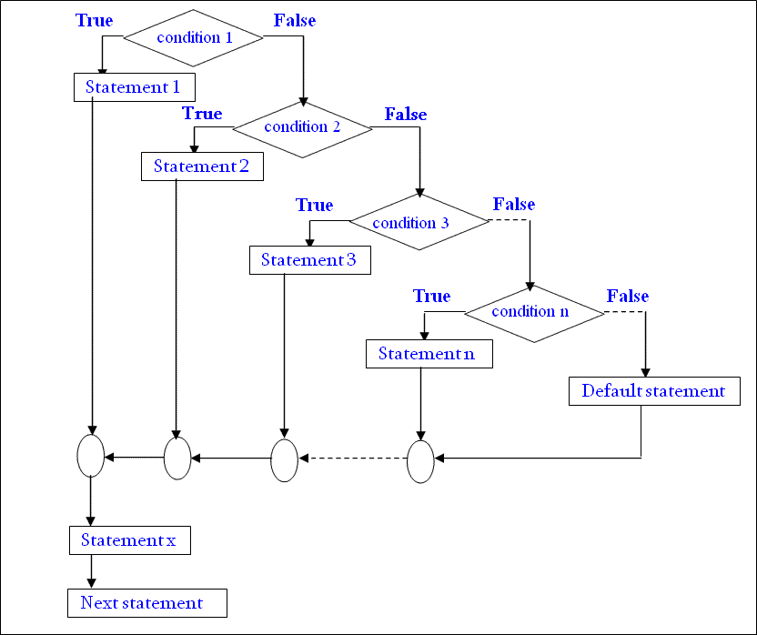
else_if ladder Statement

Slide 20
Program using if-else ladder
Write a program to determine the period of life from age.
If age above 70: Your are too old.
Age 51-70 : You are old.
Age 36-50: You are a mid age person.
Age 19-35: Your are young person.
Age 12-18: You are a teenage.
Age 0-11: You are a child.
Write a program to check a character is vowel or not.
Exercise program: 5.5 (E. Balagurusamy)

Slide 21
switch Statement
When in a program need to select so many alternatives option, we can use an if statement to control the selection.
But if number of alternatives increases, then complexity of a program also increases and it difficult to understand the program.
C has a built-in multiway decision statement known as a switch.
The switch statement tests the value of a given variable (expression) against a list of case values and when a match is found, a block of statements associated with that case is executed.

Slide 22
switch Statement
Example:
index=marks/10;
switch (index)
{
case 10:
case 9:
case 8:
printf(" Honours ");
break;
case 7:
case 6:
printf(“ First Division ");
break;
case 5:
printf(“ Second Division ");
break;
case 4:
printf(“ Third Division ");
break;
default:
printf( “ Fail ");
break;
}
Format:
switch ( expression )
{
case value-1:
statements;
break;
case value-2:
statements;
break;
. . . . . . . . . . . . . . .
. . . . . . . . . . . . . . .
default:
statements;
break;
}

Slide 23
switch Statement (cont.)
The expression is an integer expression or characters.
Each case value should be unique within a switch statement.
case labels end with a colon (:).
When switch is executed, the value of the expression is compared against the value value-1, value-2 …. If a case matched then the block of statements are executed.
value in case should be constant, error if variable use.
The break statement at the end of each block indicates end of particular case and exit from switch statement.
The switch also permitted to use nested switch statement.
The default is an optional case.
If present: executed if other cases value are not matched.
If not present: no action if all cases are failed.

Slide 24
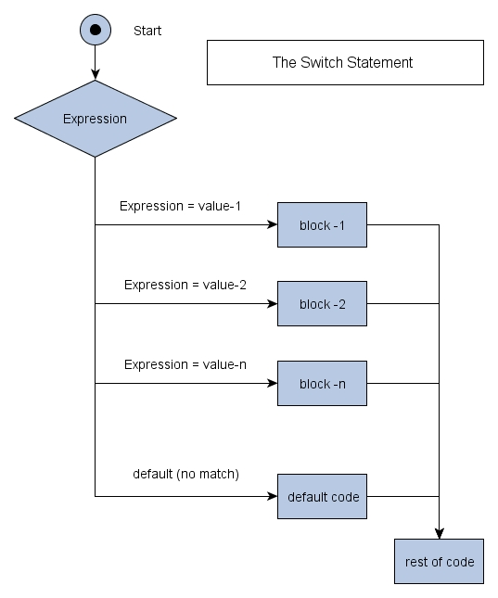
switch Statement (flowchart)

Slide 25
The ?: Operator (Conditional Operator)
The C has an unusual operator, useful for making two-way decisions. This operator is a combination of ? and :
It has three parts and takes three operands.
Format:
conditional_expression ? expression-1 : expression-2
max = (a>b?a:b)
The conditional expression is evaluated first.
If the result is nonzero, expression-1 is evaluated.
Otherwise expression-2 is evaluated.
Condition ? True output /1st expression : false output/2nd expr

Slide 26
Condition ? True output /1st expression : false output/2nd expr
If(condition){true output/1st expression}else{false output/2nd expression}
If(a>b){print a}else {print b}
a>b ? a : b

Slide 27
goto Statement
To jump one point to another point in a program goto statement is used.
The goto statement is an unconditional branching statement.
Although maximum programmers usually try to avoid goto.
The goto requires a label in order to identify the place where the program execution is transferred.
Label can be anywhere in the program, follow by a colon.
The goto statement break the normal sequential execution of the program.
Forward Jump and Backward Jump
Use of goto statement is highly discouraged in any programming language because it makes difficult to trace the control flow of a program, making the program hard to understand and hard to modify.

Slide 28
goto Statement
Format 1:
goto label;
. . . . . . . . .
. . . . . . . . .
label:
statements;
Format 2:
label:
statements;
. . . . . . . . .
. . . . . . . . .
goto label;
Example:
main()
{
double x,y;
read:
scanf("%lf",&x);
if(x<0)
goto read;
y=sqrt(x);
printf("%lf",y);
goto read;
}

Slide 29
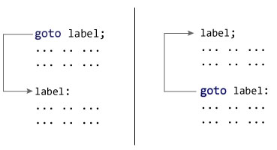
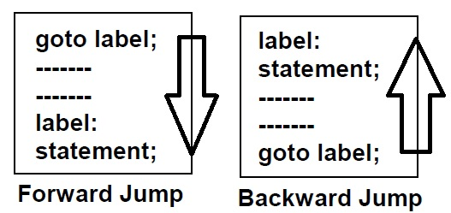
goto Statement
Forward Jump
Backward Jump

Slide 30
Programming Exercise:
Exercise: 5.1, 5.2, 5.4, 5.5, 5.10, 5.11, 5.12
Write a program to determine square of a number which is divisible by 6 but not divisible by 4.

Slide 31
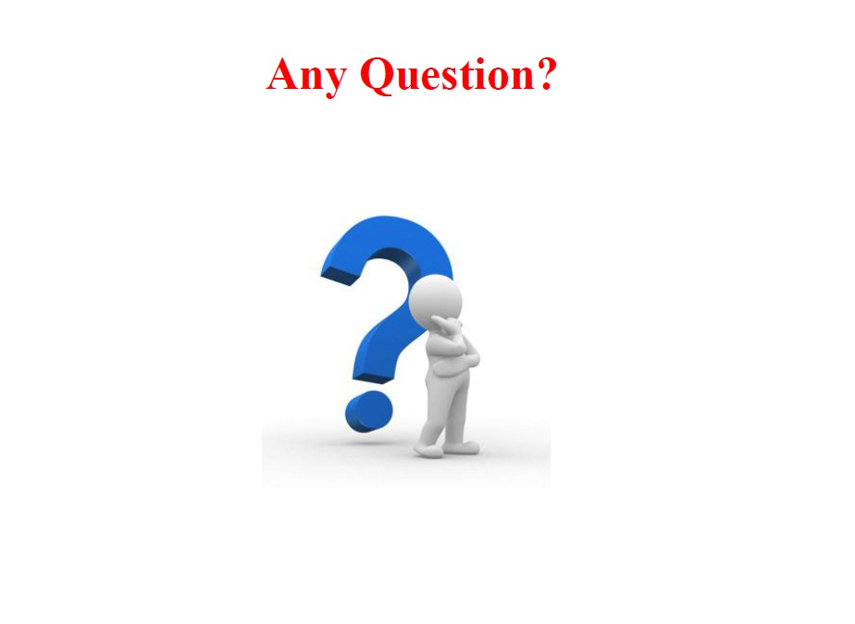

Slide 32
Thank You All

